Slide 1
Beyond the “Short List”
What other restrictive lung diseases are associated with occupational or environmental exposures?
What proportion of these conditions may be linked in the way (PAR%)?

Slide 2
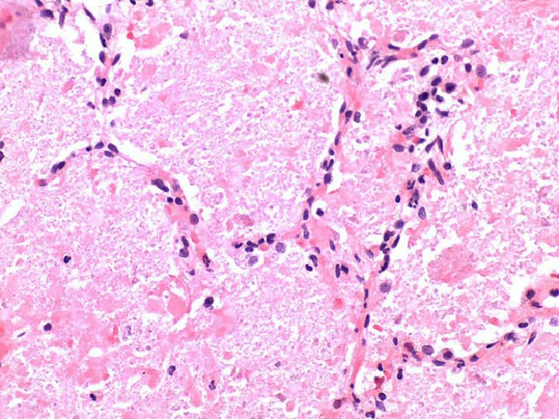
Pulmonary Alveolar Proteinosis

Slide 3
Pulmonary Alveolar Proteinosis (PAP)
1958 – PAP first described
1969 – review of 139 published cases: ~50% exposed to dusts/fumes; 7% to silica
1978 – 37 cases: 35% exposed dusts/fumes
2002 – 41 cases: 39% exposed to dusts
2011 - 70 cases: 54% exposed to dust

Slide 4
Pulmonary Alveolar Proteinosis
Key Points:
“Acute silicosis” pathology = PAP
Experimental models: silica → PAP

Slide 5
PAP as an “Orphan”
Occupational Lung Disease
Often taken as idiopathic, but…
¼ - ½ of cases are occupational (PAR 25-50%)
Silica is a major contributor
Other dusts: silicates, cement, titanium, aluminum
Can but need not be short latency - delayed time course also possible
Anti-GCSF antibodies can be positive

Slide 6
Other “Orphan” Restrictive Disease Candidates to Consider If…..
Substantial “idiopathic” component
Not already receiving a lot of attention
“Population Attributable Risk” not trivial [~10% or greater]

Slide 7
Well Established Occupational Factors in Uncommon Respiratory Diseases
Disease Entity
Giant Cell Interstitial Pneumonia
Lipoid Pneumonia
Diffuse Pulmonary Hemorrhage
Occupational Role [PAR%]
Hard metal/cobalt [~100%]
Oil spraying/aerosols [50%]
Anhydrides [<1%?]

Slide 8
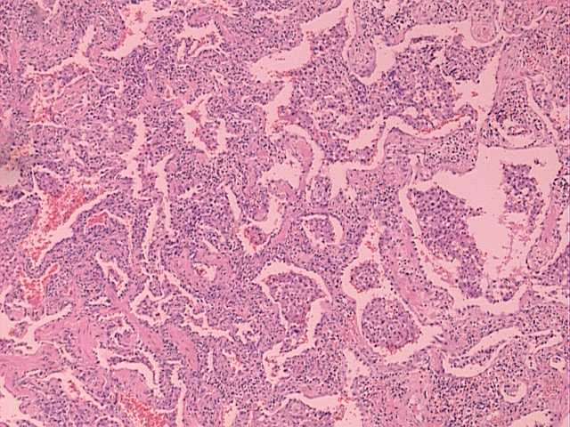
Hard Metal Disease

Slide 9
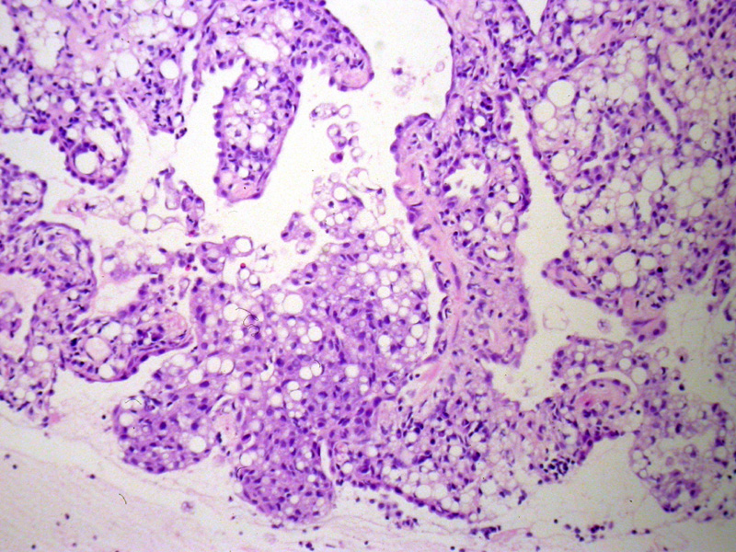
Lipoid Pneumonia

Slide 10
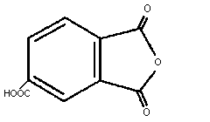
Trimellitic Anhydride

Slide 11
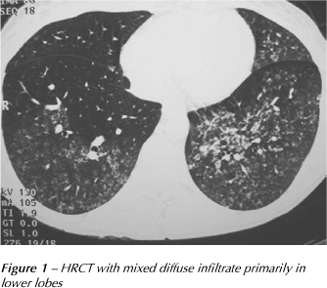
Diffuse Hemorrhage

Slide 12
What About Other Conditions?

Slide 13


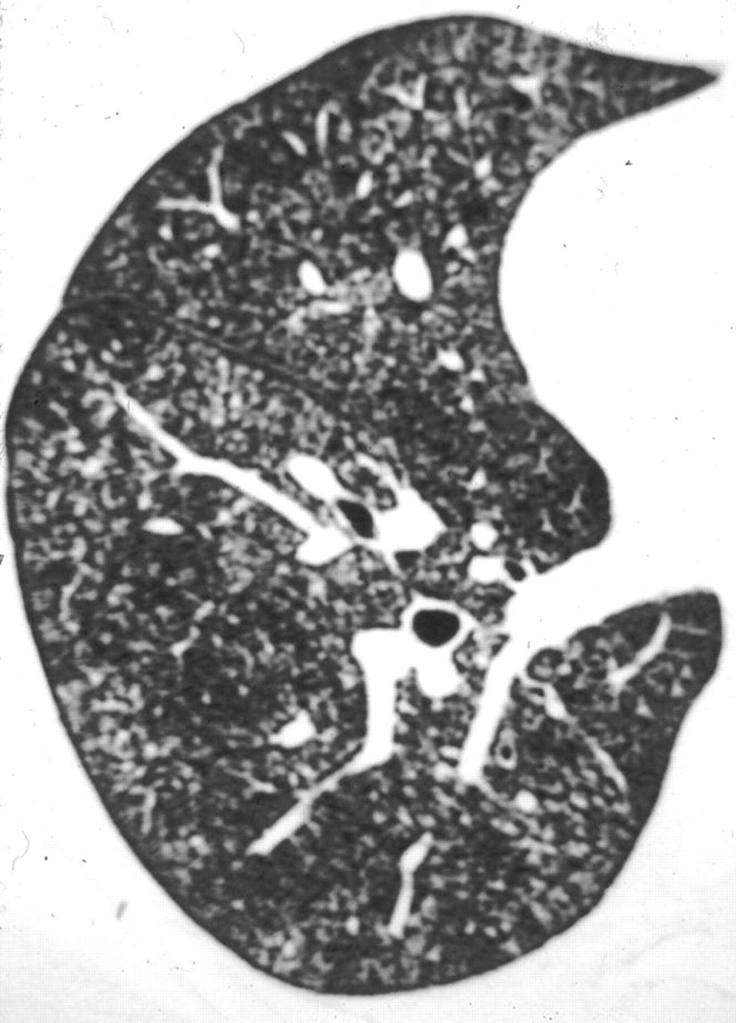

What about BOOP?
Ardystil syndrome in 40-year-old woman who was textile printing worker.
Toxicity in textile air-brushing in Spain
SIR: During February to November, 1992, five women and one man (aged 18-52, mean 35) who worked in textile air-brushing in the Community of Valencia died. Twenty-two cases were seriously intoxicated. … The diagnosis, established by Spanish and English specialists, was bronchiolitis obliterans organising pneumonia after occupational inhalation of toxic substances in all cases.
Flors L et al. AJR 2010;194:W20-W26
©2010 by American Roentgen Ray Society
Notes:
—Ardystil syndrome in 40-year-old woman who was textile printing worker. High-resolution CT image shows small diffuse centrilobular nodules. Transbronchial biopsy showed changes of organizing pneumonia.

Slide 14
What About BOOP Other than from Ardystiyl?
Few Occupational Case Reports:
Chen et. al. Ann Thorac Surgery 2012 | Heated polyester paint (also contained titanium) | Pathological confirmation
Ribeiro et. al. Revista Portug Pneum 2011 | Gold pigment inhalation in art restorer | Pathological confirmation
Sanchez-Ortiz et. al. Respir Med 2011 | Ortho-phenylenediamine in chemistry lab | CT changes and BAL with specific inhalation challenge
Sheu et. al. (letter) Thorax 2008 | Acetic acid acute inhalation | Data suggest the case is more consistent with OB

Slide 15
Idiopathic Interstitial Pneumonia
Cryptogenic Organizing Pneumonia (BOOP)
Occupational cases are rare save the the Ardystil outbreaks
PAR% is likely to be far less than <5%
2002 ATS/ERS statement → COP 2° to Dx’d cause = “COP pattern 2° to X” - not “COP”

Slide 16
Key Document Complicating Occupation and Nomenclature
American Thoracic Society/European Respiratory
Society International Multidisciplinary Consensus
Classification of the Idiopathic Interstitial Pneumonias
THIS JOINT STATEMENT OF THE AMERICAN THORACIC SOCIETY (ATS), AND THE EUROPEAN RESPIRATORY SOCIETY (ERS) WAS ADOPTED BY THE ATS BOARD OF DIRECTORS, JUNE 2001 AND BY THE ERS EXECUTIVE COMMITTEE, JUNE 2001

Slide 17
What About Idiopathic Pulmonary Fibrosis (CFA)?
9 studies (1990-2011): ↑ occupational risk; Metal dusts, wood dusts most consistent
Hubbard et. al. (Lancet 1996) est. PAR=15%
Miyake et. al. (Ann Occ Hyg 2005) “metal” OR=9.6; 12% exposed → PAR 11%
Gustafson et. al. (Resp Med 2007) “wood” est. PAR=15% (for “pulmonary fibrosis”)
Garcia-Sancho et. al. (Resp Med 2011) dusts etc. 77% of 100 cases exposed, OR 2.4; PAR% =54%

Slide 18
Magnus Ekström, et al. Effects of smoking, gender and occupational exposure on the risk of severe pulmonary fibrosis: a population-based case-control study BMJOpen 2014;4:e004018
Effect of smoking on the adjusted risk of pulmonary fibrosis (PF) or IPF, by gender and occupational exposure.
171 patients (cases) started a long-term oxygen therapy for PF (137 of whom dx as IPF); 719 random control participants served as referents.
 | PF OR (95% CI) |  | IPF OR (95% CI)
 | Women | Men | Women | Men
No occupational exposure | 1.10 (0.50 to 2.42) | 1.97 (0.64 to 6.13) | 1.12 (0. 49 to 2.59) | 1.44 (0.43 to 4.83)
Occupational exposure | 1.10 (0.52 to 2.34) | 4.63 (2.08 to 10.33) | 1.32 (0.58 to 3.03) | 2.96 (1.34 to 6.52)

Slide 19
Idiopathic Pulmonary Fibrosis: Challenges
“Missed” pneumoconiosis does not = IPF
Biopsies are not universal in IPF
Biopsy dx’d UIP does not exclude HP
Complicated smoking effects?
2002 ATS/ERS statement→ IPF 2° to Dx’d cause = “UIP pattern 2° to X” - not “IPF”

Slide 20
What About Idiopathic Interstitial Pneumonia
Respiratory Bronchiolitis-ILD and DIP?
Felt to be entirely smoking associated, e.g., smoking related PAR near 100%
Disease occurs (rarely) in non-smokers
2002 ATS/ERS statement still considers these “idiopathic pneumonias”
Does not exclude occupational interaction

Slide 21
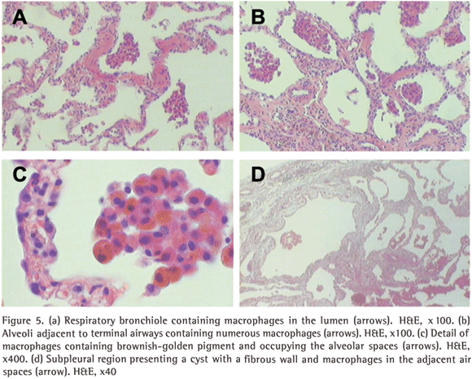

Slide 22
What About Respiratory Bronchiolitis (RB); RB-ILD or DIP?
Occupational/Environmental Case Reports:
Moon et. al. Thorax 1999 | 13 RB-ILD/168 interstitial; of 10 with data 1 non smoker with solder flux | RB-ILD
Fraig et. al. Am J Surg Path 2002 | 1 case each: SHS and diesel exhaust/ fiberglass | RB (mild to absent fibrosis)
Newman et. al. Rad Res 2005 | Plutonium | RB + DIP
Woo OH et. al. Am J Rad 2007 | SHS (occupational as waitress) | RB-ILD
Dikensoy O et. al. J Occ Health 2008 / Dagli CE et. al. Biol Trace Elem Res 2010 | Turkish pot tinners and copper workers | RB-ILD (radiographic dx)
Herbert et. Al. Hum Pathol 1982 | Aluminum welder (topped smoking 20 years before) | DIP

Slide 23
Pulmonary Fibrosis:
Specific Occupational Syndromes
“Rare Earth Pneumoconiosis” [Cerium]
Plutonium-Associated Fibrosis
Indium-Tin Oxide (also linked to PAP)
“Flock-Workers Lung” (lymphocytic bronchiolitis)
Pleuropulmonary injury in polyacralate workers

Slide 24
“Airway-Centered Interstitial Fibrosis”
New term, proposed in 2004
Restrictive disease
Fibrotic bronchiolar disease + interstitial fibrosis
Like respiratory bronchiolitis but not heavy smokers
8/12 cases: occupational-environmental factors, broadly defined

Slide 25
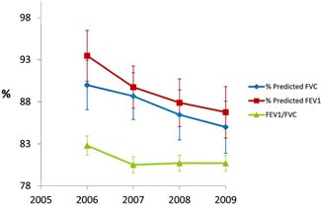
WHAT ABOUT “RESTRICTION” IN WORK-RELATED BROCNHIOLITIS OBLITERANS?
Restrictive pattern: 30/106 (28%) employees (22, mild; 6, moderate; 1, moderately severe; 1, severe ). Obstruction: 2 employees , mild; 1, moderate; 1 severe mixed pattern. Smoking → 3.7 times the prevalence of abnormal restriction compared to the U.S. population (adjusted age, gender, race, ever smoking, and BMI (95% CI 2.6–5.3).
Kreiss K.
Work-related spirometric restriction in flavoring manufacturing workers.
Am J Ind Med 2014; 57:129-37

Slide 26
Additional Conditions to Consider:
Pulmonary Histiocytosis X –Langerhans cell histiocytosis (LCH)
Smoking is related to risk; other inhalational triggers might be suspected
Venkatramani R et al, Pediatr Blood Cancer 2012: Study of childhood LCH - parental occupational exposure to “metal, granites, or wood dust” OR for LCH = 2.48

